Slide 1
Are We Alone? 我們孤苦無依嗎? John 約翰福音14:15-21

Slide 2
“Is there anyone who loves me?” “有人愛我嗎?” “Will I always be alone?” “我會永遠孤單一人嗎?“ “Why was I abandoned?” “為什麼我被拋棄了?”

Slide 3
“Is there anyone who loves me?” “有人愛我嗎?”
“Will I always be alone?” “我會永遠孤單一人嗎?“
“Why was I abandoned?” “為什麼我被拋棄了?”

Slide 4
“I won’t leave you as orphans. I will come to you.” John 14:18 我不會撇下你們為孤兒，我要回到你們這裡來。約翰福音 14:18

Slide 5
“I will pray to the Father and He will give you another Helper.” John 14:16 我要請求父，他就會賜給你們另一位保惠師，使他跟你們永遠在一起。約翰福音 14:16

Slide 6
Paraclete
Holy Spirit 聖靈
Counselor 謀士
Comforter 安慰者
Advocate 保惠師
Helper 幫助者

Slide 7
What Jesus did with the disciples, the Holy Spirit will do with and IN them.
耶穌對門徒所做的一切, 聖靈也會對他們有同樣工作，並且在他們心裡做工

Slide 8
Some of the things the Holy Spirit does in and for us: 下面幾項是聖靈在我們裡面做工的證明:
He helps us understand what the Bible teaches. John 16:13; 1 Cor. 2:13
聖靈幫助我們了解聖經的教導. 約翰福音 16:13; 哥前 2:13
He gives us assurance that we are God’s children.
Romans 8:16
聖靈證明我們是上帝的兒女. 羅馬書 8:16
He helps us want to do what pleases God. . Romans 12:11
聖靈幫助我們願意做上帝喜悅的事. 羅馬書 12:11

Slide 9
Some of the things the Holy Spirit does in and for us:下面幾項是聖靈在我們裡面做工的證明:
He helps us to feel joy as we serve Jesus and when we do the right things. Romans 14:17-18
當我們事奉耶穌和做正確的事時, 聖靈讓我們感到喜樂. 羅 馬書 14:17-18
He helps us not want to do what doesn’t please God. Galatians 5:16
聖靈讓我們不做讓上帝不喜悅的事. 加拉太書 5:16
He helps us to become more like Jesus, especially in loving other people. Galatians 5:22-23
聖靈讓我們更像耶穌, 特別是在愛人方面,. 加拉太書 5:22-23

Slide 10
He makes us want to sing praises to God, in our hearts and out loud, and be thankful for God’s goodness. Ephesians 5:18-20
聖靈讓我們口唱心和地感謝讚美主 . 以弗所書 5:18-20

Slide 11
“If you love Me, you will keep My commands.” John 14:15 你 們 若 愛 我 ， 就 必 遵 守 我 的 命 令 。約翰福音 14:15

Slide 12
“If you love Me, you will keep My commands.” John 14:15 你 們 若 愛 我 ， 就 必 遵 守 我 的 命 令 。約翰福音 14:15

Slide 13
“If you love Me, you will keep My commands.” John 14:15 你 們 若 愛 我 ， 就 必 遵 守 我 的 命 令 。約翰福音 14:15

Slide 14
1. To obey Christ’s commandments, we first must know them. John 14:21 要順服基督的誡命, 我們首先要了解這些誡命.約翰福音 14:21

Slide 15
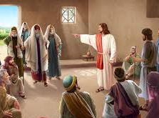
2. To obey Christ’s commandments, we must keep them. 要順服基督的誡命, 我們必須遵行這些誡命
“Why do you call Me “Lord, Lord,’ but not do what I say?” Luke 6:46
你 們 為 甚 麼 稱 呼 我 主 阿 ， 主 阿 ， 卻 不 遵 我 的 話 行 呢 ？路加福音 6:46

Slide 16
Obedience begins on the heart or thought level and demonstrates it by actions.
順服源自於內心思考後, 透過行動表現出來

Slide 17
It isn’t about perfection, but rather about direction.
順服並非是完美的執行，而是我們願意朝這個方向努力
“Not that I have already obtained all this, or have already arrived at my goal, but I press on to take hold of that for which Christ Jesus took hold of me.” Philippians 3:13-14

Slide 18
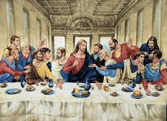
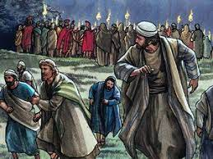
“They have kept/obeyed Your word.” John 17:6b 他 們 也 遵 守 了 你 的 道. 約翰福音 17:6b

Slide 19
Two things are true of every Christian 關於每位基督徒的2件事
First, deep down in the Christian’s heart there is an intense, steady longing and yearning to please God. This yearning may be stronger in some than in others, and in each of us it is stronger at some times than at others; nevertheless, it is there!
首先, 在基督徒的內心有強烈的渴望要討神喜悅。
這種渴望在有些人內心或者某些時候要強一些,
然而不管程度如何, 這種渴望都存在每位基督徒內心

Slide 20
Second, no real Christian fully realizes this perfection.. 第二，沒有一位基督徒可以完全得著聖靈而成聖
“Not that I have already obtained all this, or have already arrived at my goal, but I press on to take hold of that for which Christ Jesus took hold of me.” Philippians 3:12
這 不 是 說 我 已 經 得 著 了 ， 已 經 完 全 了 ； 我 乃 是 竭 力 追 求 ， 或 者 可 以 得 著 基 督 耶 穌 所 以 得 著 我 的 （ 或 作 ： 所 要 我 得 的 ） 。 腓立比書 3:12

Slide 21
Two things that will help us keep Christ’s commandments: 有兩件事可以幫助我們遵行基督誡命
1. REALIZING CHRIST’S INDWELLING PRESENCE WILL HELP US KEEP HIS COMMANDMENTS.
認識到基督內住在我們裡面會幫助我們遵行他的誡命

Slide 22
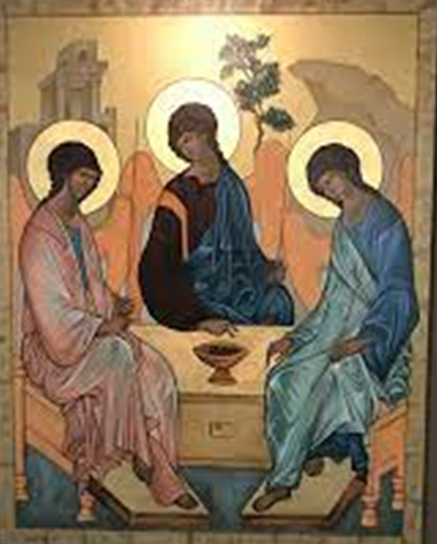
Jesus replied, “Anyone who loves Me will obey My teaching. My Father will love them, and we will come to them and make our home with them. John 14:23

Slide 23
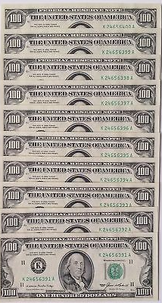
If we treasure His presence, we will be careful to walk in obedience.
假如我們珍視祂的同在, 我們便會小心遵行他的誡命

Slide 24
2. RELYING ON CHRIST’S INDWELLING SPIRIT WILL HELP US KEEP HIS COMMANDMENTS. 依靠基督內住在我們裡面的聖靈會幫助我們遵行他的誡命

Slide 26
“For whatever you have done for the least of these brothers and sisters of mine, you have done for Me.” Matthew 25:40 王 要 回 答 說 ： 我 實 在 告 訴 你 們 ， 這 些 事 你 們 既 做 在 我 這 弟 兄 中 一 個 最 小 的 身 上 ， 就 是 做 在 我 身 上 了 。 馬太福音 25:40

Slide 28
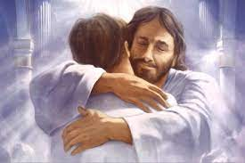
“Whoever has My commandments and keeps them is the one who loves Me. The one who loves Me will be loved by My Father, and I too will love them and show Myself to them.” John 14:21
有 了 我 的 命 令 又 遵 守 的 ， 這 人 就 是 愛 我 的 ； 愛 我 的 必 蒙 我 父 愛 他 ， 我 也 要 愛 他 ， 並 且 要 向 他 顯 現 。 約翰福音 14:21

Slide 29
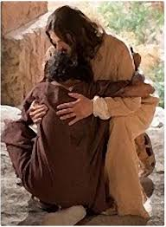
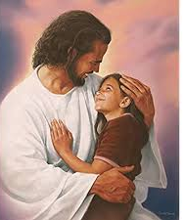
Thank God for His Holy Spirit that is with us and in us and we are not alone.
感謝神賜聖靈與我們同在, 讓我們並不孤單

Slide 30
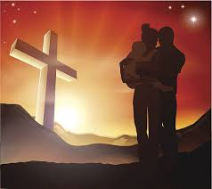
Listen to the Holy Spirit and obey Him as He leads us.
讓我們聆聽聖靈的聲音，並遵行祂的帶領

Slide 32
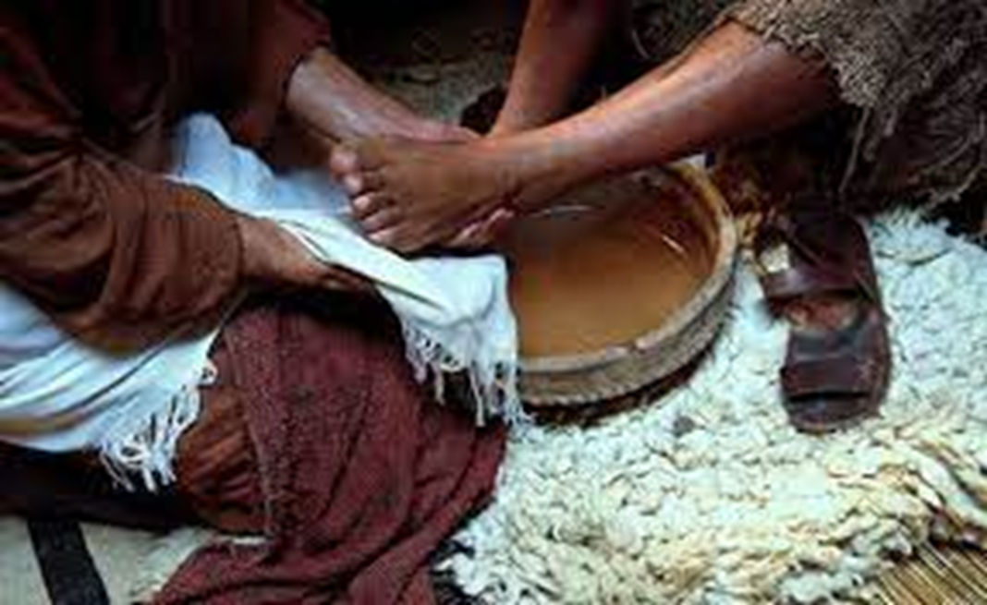
“You call me ‘Teacher’ and ‘Lord,’ and rightly so, for that is what I am. ¹⁴ Now that I, your Lord and Teacher, have washed your feet, you also should wash one another’s feet.” John 13:13-14

